Slide 1
Digital Analytics for an E-Commerce Company
Name: Komal Lunawat
Date: 22/08/2026

Slide 2
Company Overview
Business Context & Problem Statement
Client: A newly launched e-commerce retail startup selling stuffed animal toys, operating on a custom-built e-commerce platform since March 2012. As of the latest data (March 2015), the company has been live for ~3 years.
Trigger: CEO Cindy Sharp is raising a larger VC funding round from a top West Coast firm and needs the analytics team to translate three years of raw operational data into a compelling, data-driven growth story, plus reusable tools stakeholders can monitor going forward.
Problem Statement: Build a repeatable analytics capability — cleaned data, KPI dashboards, performance analysis, new-product analysis, and predictive analytics — that (a) supports Cindy's investor narrative and (b) becomes an ongoing decision-support tool for the CEO, Website Manager, and Marketing Director.

Slide 3
Stakeholder Information
Cindy Sharp-CEO
Focused on investor relations, securing capital, and long-term company growth metrics.
Morgan Rockwell-Website Manager
Focused on web performance, conversion funnels, session tracking, and user experience.
Tom Parmesan-Marketing Director
Focused on campaign returns, product promos, user acquisition cost, and revenue growth.

Slide 4
Technology Stack
Layer | Tool | Purpose
Data storage / checks | SQL Server | Imports the raw data sheets and hosts the main database. Every auditing query and cleaning step — fixing wrong prices, removing errors
Data prep / analysis | Python (pandas) | Cleaning, joining, feature engineering, EDA
Predictive modeling | Python (scikit-learn) — Linear/Logistic Regression | Forecasting & classification per Predictive Analysis Plan
Dashboarding / BI | Power BI | Builds clean, interactive dashboards for business managers, connecting directly to the cleaned SQL database to show daily performance charts.
Documentation | Microsoft Powerpoint | The final platform for presenting the entire project to stakeholders — documenting data issues, cleaning steps, business insights, and dashboard plans in a clean business format.

Slide 5
Scope of Work / Deliverables
Data preparation: Clean, join, and validate the six tables into an analysis-ready model (sessions → pageviews → orders → order items → refunds → products).
KPI framework: Define core metrics — sessions, conversion rate, orders, revenue, AOV, COGS/margin, refund rate, repeat session rate — at company, channel, and product level.
Exploratory & performance analysis: Trended and segmented analysis of growth, channel mix shifts, device mix, and funnel drop-off (session → pageview → order).
New product analysis: Performance of each product post-launch — adoption curve, cross-sell/cannibalization effects on The Original Mr. Fuzzy, margin contribution.
Dashboards (4 analysis views):
Channel Analysis: revenue trend, conversion, refund rate by channel — for the Marketing Director.
Product Analysis: margin & product mix trend — for the CEO.
Customer Analysis: session funnel & device mix — for the Website Manager.
Pageview Analysis: bounce rate & page drop-off — for the Website Manager.
Predictive analytics: A forecasting model (e.g., time-series forecast of monthly orders/revenue) to support forward-looking planning.
Final presentation/report: A synthesized narrative connecting the data to the growth story for investors.

Slide 6
Proposed Approach / Methodology
Data understanding & cleaning — profile all six tables, check referential integrity, handle nulls (e.g., missing UTM values as "direct/unknown" traffic).
Data modeling — build a unified analysis dataset joining sessions → orders → order items → refunds → products.
Exploratory data analysis (EDA) — trend, funnel, and segment analysis in Python/SQL.
KPI & metric design — align definitions with stakeholder needs before dashboard build.
Dashboarding — build interactive dashboards (e.g., Power BI/Tableau or equivalent) per stakeholder.
Predictive modeling — select and validate a forecasting approach; back-test against historical months.
Storytelling & delivery — package findings into a report/deck aligned to the investor narrative Cindy needs.

Slide 7
Assumptions
"3 years in market" (per CEO's email) aligns with the observed data range (Mar 2012–Mar 2015); this is treated as the full analysis window.
is_repeat_session and other pre-computed flags in the source data are trusted as correct unless contradicted by validation (see Deliverable 02).
Currency is USD throughout; no currency conversion needed.
One BI tool will be used to build all three stakeholder dashboards (single source of truth), rather than separate tools per stakeholder.
Refunds reduce net revenue but the orders/order_items price_usd fields represent gross order value (not net of refunds) unless stated otherwise.
No customer demographic or marketing spend/cost data is available — channel efficiency will be measured via conversion rate and volume, not true CAC/ROI (since ad spend isn't in the dataset).

Slide 8
Four Types of Analysis
Descriptive — What happened?
Diagnostic — Why did it happen?
Descriptive — What happened?
Monthly sessions, orders & revenue trend
Totals: conversion rate & average order value
Revenue share per product
Channel / device / campaign split
Refund rate by product & campaign
Conversion rate by channel & device
Profit margin by order and product
Data-quality findings explain anomalies
Predictive — What's likely next?
Prescriptive — What should we do?
Forecast sessions, orders & revenue
Estimate refund likelihood by product
Project seasonal demand per product
Shift budget to high-converting channels
Flag high refund-rate products for review
Recommend AOV-lifting actions
Prioritize restocking top revenue drivers

Slide 9
EDA Plan — Descriptive Analysis
Monthly trend of sessions, orders, and revenue.
Conversion rate (sessions → orders) and average order value (AOV).
Revenue and % revenue share by product.
Overall refund rate, and refund rate broken down by product.
Session and revenue split by channel, source, and device type.
Weekday vs. weekend order volume, and new vs. repeat session performance.

Slide 10
EDA Plan — Diagnostic Analysis
Which acquisition channels convert best — and which drive higher refund rates? Compares source/campaign performance against refund rate to separate genuinely strong channels from ones that just generate volume.
Which products drive revenue vs. which drive refunds? Cross-checks product revenue share against product-level refund rate to flag profitable-but-risky SKUs.
Where does the session-to-order funnel lose people? Breaks the funnel down by device and channel to find where drop-off concentrates.
Does page-level bounce behavior explain low conversion on certain pages? Links bounce rate and pageviews-per-session by URL to conversion outcomes.

Slide 11
Data Understanding and Auditing (1/6)
Website Sessions table — field-by-field review
Total rows: 472,871 rows
Date range: 19 Mar 2012 – 19 Mar 2015
Field | Description | Data Type
website_session_id | Unique ID for each website visit. | int
created_at | Date and time the session started. | Date
user_id | Identifies the visitor associated with the session. | int
is_repeat_session | Flags whether this is a repeat visit (1) or a new visit (0). | int
utm_source | The marketing source that drove the session (e.g. a search engine or social platform). | string
utm_campaign | The marketing campaign associated with the session. | string
utm_content | The specific ad or content variant associated with the session. | string
device_type | The type of device used for the session (desktop or mobile). | string
http_referer | The referring website or search engine for the session. | string

Slide 12
Data Understanding and Auditing (2/6)
Total rows: 1,188,124 rows
Website Pageviews table — field-by-field review
Date range: 19 Mar 2012 – 19 Mar 2015
Field | Description | Data Type
website_pageview_id | Unique ID for each page viewed. | int
created_at | Date and time the page was viewed. | Date
website_session_id | Connects the page view to the session it belongs to. | int
pageview_url | The specific page URL that was viewed. | string

Slide 13
Data Understanding and Auditing (3/6)
Orders table — field-by-field review
Total rows: 32,313 rows
Date range: 19 Mar 2012 – 19 Mar 2015
Field | Description | Data Type
order_id | Unique ID given to each customer order. | int
created_at | Date and time when the order was created. | Date
website_session_id | Connects the order with the website session through which it was placed. | int
user_id | Identifies the customer who placed the order. | int
primary_product_id | Identifies the main/primary product purchased in the order. | int
items_purchased | Number of items/products purchased in the order. | int
price_usd | Revenue generated from the order. | float
cogs_usd | Cost of the products in the order. | float

Slide 14
Data Understanding and Auditing (4/6)
Order Items table — field-by-field review
Total rows: 40,025 rows
Date range: 19 Mar 2012 – 19 Mar 2015
Field | Description | Data Type
order_item_id | Unique ID for each individual item within an order. | int
created_at | Date and time the item record was created. | Date
order_id | Connects the item to the order it belongs to. | int
product_id | Identifies which product this item is. | int
is_primary_item | Flags whether this is the main product in the order (1) or an add-on (0). | float
price_usd | Revenue generated from this item. | float
cogs_usd | Cost of this item. | float

Slide 15
Data Understanding and Auditing (5/6)
Products table — field-by-field review
Total rows: 4 rows
Date range: 19 Mar 2012 – 19 Mar 2015
Field | Description | Data Type
product_id | Unique ID for each product. | int
created_at | The date the product was launched. | Date
product_name | The name of the product. | string

Slide 16
Data Understanding and Auditing (6/6)
Order Item Refunds table — field-by-field review
Total rows: 1,731 rows
Date range: 6 Apr 2012 – 1 Apr 2015
Field | Description | Data Type
order_item_refund_id | Unique ID for each refund record. | int
created_at | Date and time the refund was processed. | Date
order_item_id | Connects the refund to the specific item that was refunded. | int
order_id | Connects the refund to the order it belongs to. | int
refund_amount_usd | The dollar amount refunded. | float

Slide 17
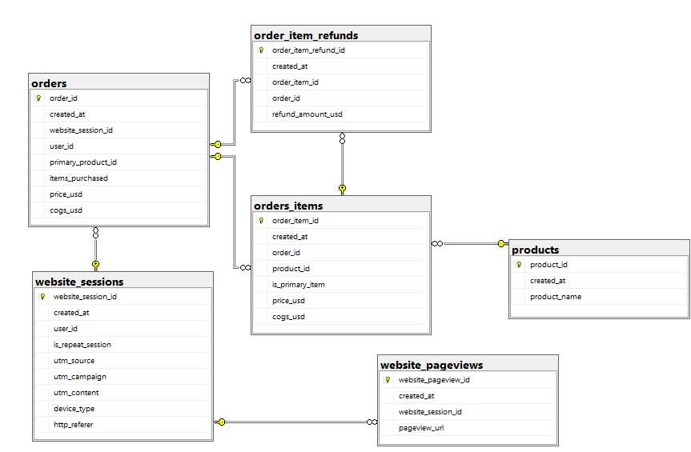
Entity Relationship Diagram
How the six tables connect to one another.

Slide 18
ER-Diagram Relationships
Each table's unique identifier, and how it links to the rest of the model.
Table | Primary Key | Foreign Key(s) | References
website_sessions | website_session_id | — | The root table — every session starts here.
website_pageviews | website_pageview_id | website_session_id | website_sessions.website_session_id
orders | order_id | website_session_id | website_sessions.website_session_id
orders_items | order_item_id | order_id product_id | orders.order_id products.product_id
order_item_refunds | order_item_refund_id | order_item_id order_id | orders_items.order_item_id orders.order_id
products | product_id | — | Referenced by orders_items.product_id (enforced) and orders.primary_product_id (logical link only, no constraint).
Flow: website_sessions → orders / website_pageviews → orders_items → order_item_refunds, with products feeding orders_items.

Slide 19
SQL Data Checks — Categories
Applied across all six tables before KPI & dashboard build
Checks run: 6 categories
Scope: All 6 tables
Check category | What it verifies | Result
Primary key uniqueness | No duplicate order_item_id rows in orders_items | Zero duplicate order-item rows found
Referential integrity | Every FK has a matching parent row (6 relationships checked) | Zero orphaned records across all 6 relationships
Null / completeness audit | Which columns are NULL, and how many, on utm_source, utm_campaign, device_type | Null counts flagged on source, campaign & device
Range / logic checks | No impossible values: negative price/cogs, cogs > price, future dates | No negative prices/costs or future-dated rows found
Text / formatting audit | Leading or trailing spaces in text fields | A few product names had stray leading/trailing spaces
Row count / structure check | Confirms expected row counts per table before analysis begins | Row counts matched expected import totals on all 6 tables

Slide 20
Data Processing Plan — Issues & Resolutions
Data-quality issues identified during the audit, and how each is resolved
Issues found: 4
Fix approach: Read-only clean views
Issue | What We Found | How It's Resolved
Missing marketing dimensions | Some sessions missing utm_source, utm_campaign, or device_type | Standardized with default labels ("direct/unknown", "unspecified") so every session stays usable
Refund status not linked at item level | Refund records live in a separate table from order items | Derived an is_refunded flag joined onto each order item
Margin not pre-calculated | Profitability had to be recalculated every time it was needed | Margin (price − cost) derived once in a clean, reusable view
Minor text irregularities | A few product names carried leading/trailing whitespace | Flagged in the text-quality audit and trimmed in the clean layer
Zero orphaned / duplicate records | Verified across all 6 relationships and every primary key | No fix needed — confirms clean, trustworthy joins
One trusted, reusable layer | Every dashboard, report, and model needs a single source of truth | All fixes implemented as read-only views on top of the raw tables — original data is never modified

Slide 21
Predictive & Prescriptive Analysis Plan
Descriptive & Diagnostic (in progress via SQL / Power BI): historic KPI reporting and root-cause breakdowns by channel, product, and device.
Predictive (planned): forecast next-period revenue / order volume; flag orders at high refund risk.
Prescriptive (planned): turn predictions into action — reallocate budget toward the highest-converting channels; flag high refund-risk SKUs before shipping.
Model rationale — revenue / demand forecasting: Linear Regression, since the target (future revenue or order volume) is continuous and trend-driven.
Model rationale — refund-risk flagging: Logistic Regression as the lead candidate, since the outcome is binary (refunded / not refunded).
Evaluation: R² / RMSE for the regression forecast; precision & recall (not raw accuracy) for refund-risk, since refund cases are the minority class.

Slide 22
Predictive Models — Python (scikit-learn)
Basic → Advanced modeling on top of the cleaned SQL views
Models built: 2 tasks
Artifacts: 2 pickled pipelines
Component | Approach (Basic → Advanced) | Output / Metric
Revenue forecast | Linear Regression (trend + seasonality) → Random Forest (+ lag & rolling-avg features), TimeSeriesSplit CV | MAE, RMSE, R²
Refund likelihood | Logistic Regression → Random Forest Classifier, both in a ColumnTransformer pipeline | Accuracy, Precision, Recall, F1, ROC-AUC
Forecast features | month_index, month_of_year, revenue_lag1, orders_lag1, revenue_rolling3 | Built from monthly_kpi
Refund features | price_usd, cogs_usd, margin_usd, margin_pct, product / channel / device | Built from order_items + orders + sessions
Saved artifacts | Trained pipelines pickled for reuse without retraining | revenue_forecast_model.pkl, refund_classifier_pipeline.pkl

Slide 23
Prescriptive Analytics — Recommendation Rules
Rule-based logic in Python, applied to the descriptive / diagnostic / predictive outputs
Rules coded: 4 actions
Output: prescriptive_recommendations.csv
Action | Trigger Rule | Data Source
Flag high refund-rate products for review | Product refund_rate_pct > mean + 1 standard deviation | refund_by_product
Shift budget to high-converting channels | Each channel's conversion_rate_pct compared to overall average → increase or reduce budget | channel_perf
Recommend AOV-lifting actions | Product-level AOV below the overall AOV → bundle / cross-sell candidate | product_aov (from order_items + orders)
Prioritize restocking top revenue drivers | Top 2 products ranked by pct_of_total_revenue | product_mix

Slide 24
Key Dimensions Available
Traffic source: gsearch, bsearch, socialbook (plus null/direct)
Campaign type: nonbrand, brand, desktop_targeted, pilot
Device type: desktop, mobile
Product: 4 SKUs launched at different points across the 3-year window, enabling before/after and cross-sell analysis

Slide 25
Dashboard Layout Plan — Overview
Four report pages, each built for a specific business question
Report pages: 4 pages
Navigation: 1 home hub
Report Page | What It Shows | Primary Stakeholder
Home | Navigation hub linking every report page | All stakeholders
Channel Analysis | Which sources, campaigns & devices drive revenue — and refunds | Tom Parmesan — Marketing Director
Product Analysis | Product-level revenue, margin, cost & refund trends | Cindy Sharp — CEO
Customer Analysis | Session behavior, new vs. repeat customers, funnel drop-off | Morgan Rockwell — Website Manager
Pageview Analysis | Page-level engagement, bounce rate & revenue by landing page | Morgan Rockwell — Website Manager

Slide 26
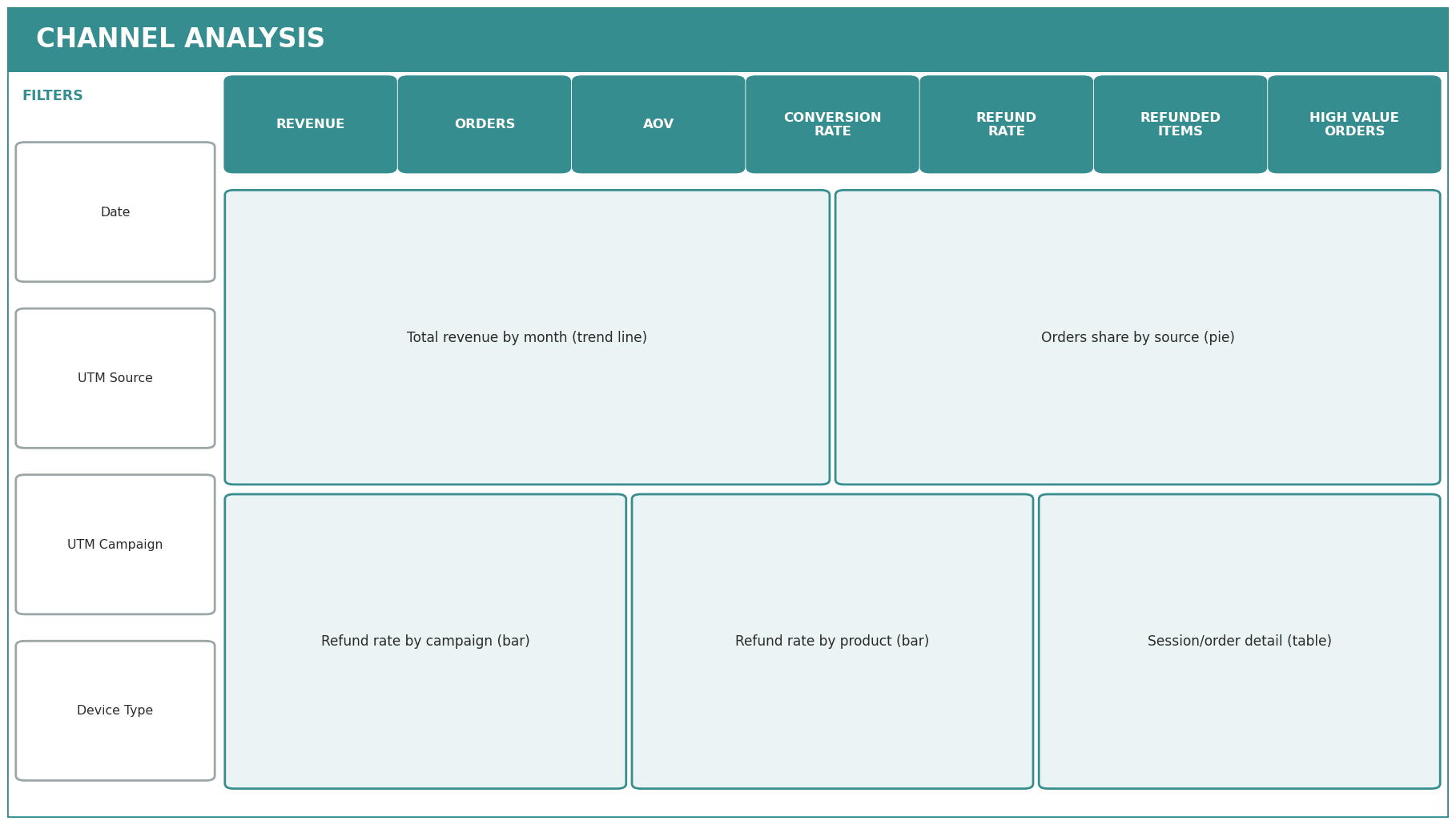
Channel Analysis
Where sessions & revenue come from, and how healthy each channel is.
What each part shows
Summary cards: revenue, orders, AOV, conversion rate, refund rate, refunded items, and high-value orders.
Revenue trend line: total revenue movement month over month.
Orders-by-source pie: which marketing sources bring the most orders.
Refund rate by campaign & by product: flags who's driving returns.
Detail table for drilling into any campaign or source.
Filters: date, UTM source, UTM campaign, device type.

Slide 27
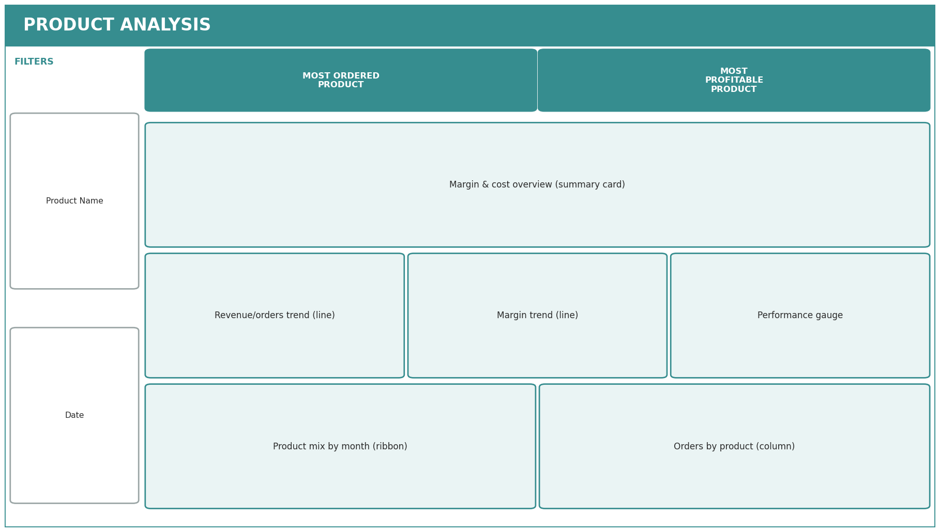
Product Analysis
Which products sell, which are most profitable, and how each is trending.
What each part shows
Top cards: single most-ordered product and most-profitable product.
Margin & cost overview: revenue, cost, and margin together.
Trend lines: order/revenue movement and margin movement over time.
Performance gauge: quick read against a target.
Product mix ribbon & orders-by-product column charts.
Filters: product name, date.

Slide 28
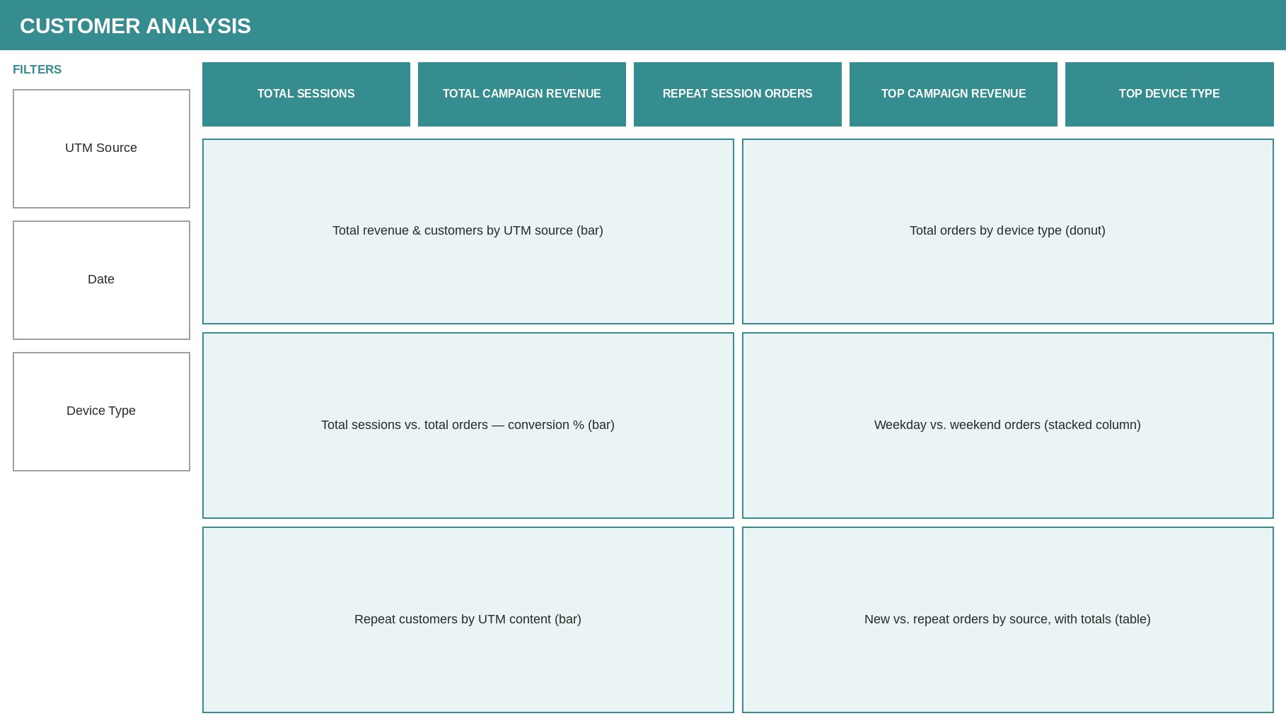
Customer Analysis
Visitor behaviour — where sessions come from, and how far they get through the funnel.
What each part shows
Summary cards: total sessions, total campaign revenue, repeat-session orders, top campaign revenue, top device type.
Revenue & customers by UTM source, plus orders by device type.
New-vs-repeat orders by source (table with totals) for drill-down — replaces a separate donut that duplicated the table’s totals.
Total sessions vs. total orders bar shows overall conversion at a glance.
Repeat customers by UTM content, and weekday vs. weekend order volume.
Filters: UTM source, device type, date.

Slide 29

Pageview Analysis
On-site browsing behaviour before a purchase decision — what gets seen, what causes visitors to leave.
What each part shows
Summary cards: total pageviews, bounce rate, pageviews per session, total sessions.
Total pageviews by page (pie) & pageview trend by month and device type (line).
Bounce rate by page (table) & revenue by page (bar) for a detailed review.
A separate bounced-sessions-by-page column chart was dropped — it duplicated the ranking already shown by the bounce-rate table and the pageview pie.
Filters: page URL, device type, date.

Slide 30
THANK YOU!

